Slide 1
Cornerstone City Church Peninsula Plus Community Hoo Are Ya
29th September 2024

Slide 2


Slide 3


Slide 4
Turn It Up
CCLI Song # 6621485
Andy Harrison
© 2012 Planetshakers Ministries Int. Inc. (Admin. by Song Solutions www.songsolutions.org)
For use solely with the SongSelect® Terms of Use. All rights reserved. www.ccli.com
CCLI Licence No. 33265

Slide 5
1/6
You are here as we lift You up
You are riding on our praise
Be enthroned over everything
You are seated in our praise

Slide 6
2/6
This is prophetic I can feel it in the air
We lift our praise and You change the atmosphere
With hearts open now everybody singing out
(Oh)
(I am free)

Slide 7
3/6
Turn it up this sound of praise
Make it louder than any other
Lift Him up and shout His name over all

Slide 8
4/6
As we praise I can feel the change
As Your presence now invades
Hear the sound of the broken chains
Prison doors are giving way

Slide 9
5/6
Our praise goes up
Your rain comes down
(REPEAT)

Slide 10
6/6
With shouts of praise we celebrate
King of glory enter in
You are riding on our praise oh Lord

Slide 11
Great Big God
CCLI Song # 3373437
Jo Hemming | Nigel Hemming
© 2001 Vineyard Songs (UK/Eire) (Admin. by Integrity Music Ltd)
For use solely with the SongSelect® Terms of Use. All rights reserved. www.ccli.com
CCLI Licence No. 33265

Slide 12
1/2
Our God is a great big God
Our God is a great big God
Our God is a great big God
And He holds us in His hands

Slide 13
2/2
He's higher than a skyscraper
And He's deeper than a submarine
He's wider than the universe
And beyond my wildest dreams
And He's known me and He's loved me
Since before the world began
How wonderful to be a part of
God's amazing plan

Slide 14
My Redeemer Lives
CCLI Song # 2397964
Reuben Morgan
© 1998 Hillsong Music Publishing Australia (Admin. by Hillsong Music Publishing UK)
For use solely with the SongSelect® Terms of Use. All rights reserved. www.ccli.com
CCLI Licence No. 33265

Slide 15
1/4
I know He rescued my soul His blood has covered my sin I believe I believe My shame He's taken away My pain is healed in His name I believe I believe
I'll raise a banner 'Cause my Lord has conquered the grave

Slide 16
2/4
My Redeemer lives
My Redeemer lives
My Redeemer lives
My Redeemer lives

Slide 17
3/4
You lift my burdens
I'll rise with You
I'm dancing on this mountain top
To see Your kingdom come

Slide 18
4/4
My Redeemer lives
My Redeemer lives
My Redeemer lives
My Redeemer lives

Slide 20
Goodness Of God
CCLI Song # 7117726
Ben Fielding | Brian Johnson | Ed Cash | Jason Ingram | Jenn Johnson
© 2018 Capitol CMG Paragon (Admin. by Capitol CMG Publishing)
Fellow Ships Music (Admin. by Essential Music Publishing LLC)
So Essential Tunes (Admin. by Essential Music Publishing LLC)
SHOUT! Music Publishing Australia (Admin. by SHOUT! Music Publishing UK)
Bethel Music Publishing (Admin. by Song Solutions)
For use solely with the SongSelect® Terms of Use. All rights reserved. www.ccli.com
CCLI Licence No. 33265

Slide 21
1/4
I love You Lord
Oh Your mercy never fails me
All my days
I've been held in Your hands
From the moment that I wake up
Until I lay my head
I will sing of the goodness of God

Slide 22
2/4
All my life You have been faithful
All my life You have been so so good
With every breath that I am able
I will sing of the goodness of God

Slide 23
3/4
I love Your voice
You have led me through the fire
In darkest night
You are close like no other
I've known You as a father
I've known You as a friend
I have lived in the goodness of God

Slide 24
4/4
Your goodness is running after
It’s running after me
(REPEAT)
With my life laid down
I’m surrendered now
I give You everything
Your goodness is running after
It's running after me

Slide 25
Great Is Thy Faithfulness
CCLI Song # 18723
Thomas Obediah Chisholm | William Marion Runyan
© Words: 1923. Renewed 1951 Hope Publishing Company; Music: 1923. Renewed 1951 Hope Publishing Company
For use solely with the SongSelect® Terms of Use. All rights reserved. www.ccli.com
CCLI Licence No. 33265

Slide 26
1/7
Great is Thy faithfulness
Great is Thy faithfulness
Morning by morning
New mercies I see
All I have needed
Thy hand hath provided
Great is Thy faithfulness
Lord unto me

Slide 27
2/7
Great is Thy faithfulness
O God my Father
There is no shadow
Of turning with Thee
Thou changest not
Thy compassions they fail not
As Thou hast been
Thou forever wilt be

Slide 28
3/7
Great is Thy faithfulness
Great is Thy faithfulness
Morning by morning
New mercies I see
All I have needed
Thy hand hath provided
Great is Thy faithfulness
Lord unto me

Slide 29
4/7
Summer and winter
And springtime and harvest
Sun moon and stars
In their courses above
Join with all nature
In manifold witness
To Thy great faithfulness
Mercy and love

Slide 30
5/7
Great is Thy faithfulness
Great is Thy faithfulness
Morning by morning
New mercies I see
All I have needed
Thy hand hath provided
Great is Thy faithfulness
Lord unto me

Slide 31
6/7
Pardon for sin
And a peace that endureth
Thy own dear presence
To cheer and to guide
Strength for today
And bright hope for tomorrow
Blessings all mine
With ten thousand beside

Slide 32
7/7
Great is Thy faithfulness
Great is Thy faithfulness
Morning by morning
New mercies I see
All I have needed
Thy hand hath provided
Great is Thy faithfulness
Lord unto me

Slide 34


Slide 35
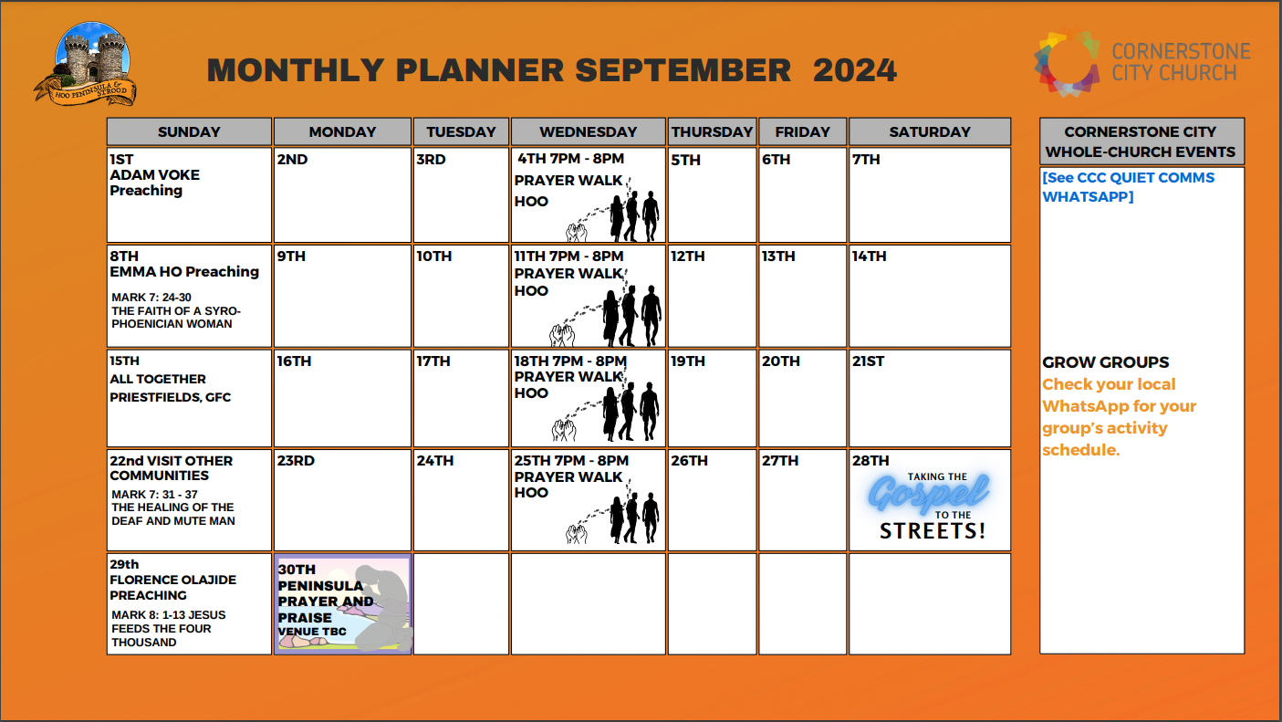

Slide 36


Slide 37
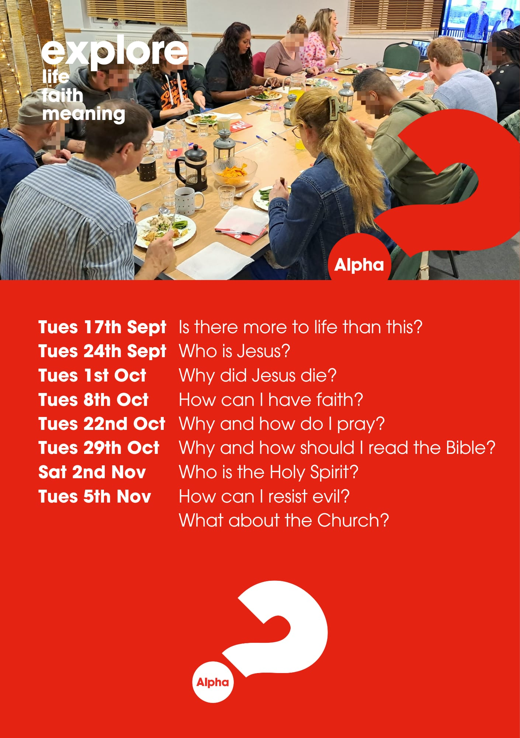

Slide 38
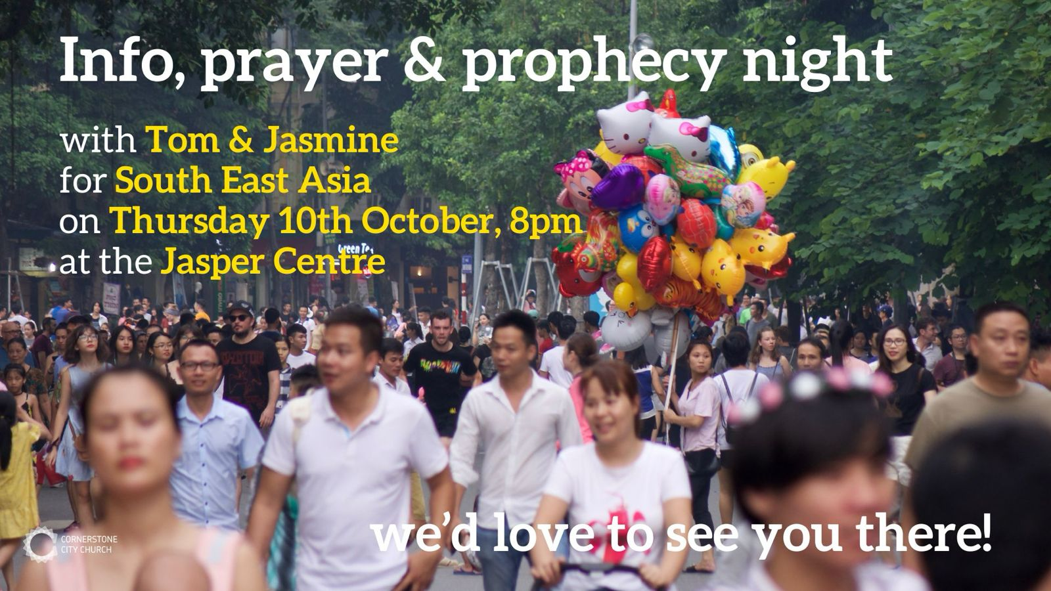

Slide 39


Slide 40
Mark 8:1 -13 (NIV)
8 During those days another large crowd gathered. Since they had nothing to eat, Jesus called his disciples to him and said, 2 “I have compassion for these people; they have already been with me three days and have nothing to eat. 3 If I send them home hungry, they will collapse on the way, because some of them have come a long distance.”
4 His disciples answered, “But where in this remote place can anyone get enough bread to feed them?”
5 “How many loaves do you have?” Jesus asked.
“Seven,” they replied.
6 He told the crowd to sit down on the ground. When he had taken the seven loaves and given thanks, he broke them and gave them to his disciples to distribute to the people, and they did so. 7 They had a few small fish as well; he gave thanks for them also and told the disciples to distribute them. 8 The people ate and were satisfied. Afterward the disciples picked up seven basketfuls of broken pieces that were left over. 9 About four thousand were present. After he had sent them away, 10 he got into the boat with his disciples and went to the region of Dalmanutha.
11 The Pharisees came and began to question Jesus. To test him, they asked him for a sign from heaven. 12 He sighed deeply and said, “Why does this generation ask for a sign? Truly I tell you, no sign will be given to it.” 13 Then he left them, got back into the boat and crossed to the other side.

Slide 41
Mark 8:1 -13 (ICB)
More Than 4,000 People Fed
8 Another time there was a great crowd with Jesus. They had nothing to eat. So Jesus called his followers to him. He said, 2 “I feel sorry for these people. They have been with me for three days, and now they have nothing to eat. 3 I cannot send them home hungry. If they leave without eating, they will faint on the way home. Some of them live a long way from here.”
4 Jesus’ followers answered, “But we are far away from any towns. Where can we get enough bread to feed all these people?”
5 Jesus asked, “How many loaves of bread do you have?”
They answered, “We have seven loaves.”
6 Jesus told the people to sit on the ground. Then he took the seven loaves and gave thanks to God. Jesus divided the bread and gave the pieces to his followers. He told them to pass out the bread to the people, and they did so. 7 The followers also had a few small fish. Jesus gave thanks for the fish and told his followers to give the fish to the people. 8 All the people ate and were satisfied. Then the followers filled seven baskets with the pieces of food that were not eaten. 9 There were about 4,000 men who ate. After they had eaten, Jesus told them to go home. 10 Then he went in a boat with his followers to the area of Dalmanutha.
The Leaders Ask for a Miracle
11 The Pharisees came to Jesus and asked him questions. They wanted to trap him. So they asked Jesus to do a miracle to show that he was from God. 12 Jesus sighed deeply. He said, “Why do you people ask for a miracle as proof? I tell you the truth. No miracle will be given to you.” 13 Then Jesus left the Pharisees. He went in the boat to the other side of the lake.

Slide 42
Lesson 1
When you stick with Jesus, he will stick with you.

Slide 43
Lesson 2
Be thankful in the ordinary, and the extraordinary will happen.

Slide 44
V8. The people ate until they were satisfied.
Afterward the disciples picked up seven basketfuls of broken pieces that were left over.
Matt 6:33 But seek first his kingdom and his righteousness, and all these things will be given to you as well.
Philippians 4:6 Do not be anxious about anything, but in every situation, by prayer and petition, with thanksgiving, present your requests to God.
Philippians 4:19 And my God will meet all your needs according to the riches of his glory in Christ Jesus.

Slide 45
Lesson 3
Seek God, want not.

Slide 46
John 20: 27 - 29
Then he said to Thomas, “Put your finger here; see my hands. Reach out your hand and put it into my side. Stop doubting and believe.”
28 Thomas said to him, “My Lord and my God!”
29 Then Jesus told him, “Because you have seen me, you have believed; blessed are those who have not seen and yet have believed.”

Slide 47
Lesson 4
Be-lieve and Be blessed

Slide 48
Four Key Lessons
Lesson 1: When you stick with Jesus, he will stick with you.
Lesson 2: Be thankful in the ordinary, and the extraordinary will happen.
Lesson 3: Seek God, want not.
Lesson 4: Believe and Be blessed.

Slide 49
He Knows My Name
CCLI Song # 2151368
Tommy Walker
© 1996 Universal Music - Brentwood Benson Songs
For use solely with the SongSelect® Terms of Use. All rights reserved. www.ccli.com
CCLI Licence No. 33265

Slide 50
1/4
I have a Maker
He formed my heart
Before even time began
My life was in His hand

Slide 51
2/4
He knows my name
He knows my every thought
He sees each tear that falls
And hears me when I call

Slide 52
3/4
I have a Father
He calls me His own
He'll never leave me
No matter where I go

Slide 53
4/4
He knows my name
He knows my every thought
He sees each tear that falls
And hears me when I call

Slide 54
2 Corinthians 14 May the grace of the Lord Jesus Christ, and the love of God, and the fellowship of the Holy Spirit be with you all

